Slide 1
Association Analysis using R
Used “arules” package to mine frequent itemsets, Apriori algorithm implementation.
Most categories have low support and confidence
Page visits concentrates in 9 out of 17 categories (support threshold = 10%):
Top 5 frequent categories: On-Air, News, Tech, Weather, Local Business. (support >= 12%)
Less frequent categories: Weather, MSN-News, Misc., MSN-Sports, Living, Health, Summary, Opinion, Travel, BBS (support <1%)
Page visits tend to concentrate in one or two categories:
73% with size = 1
18% with size = 2
9% with size >= 3

Slide 2
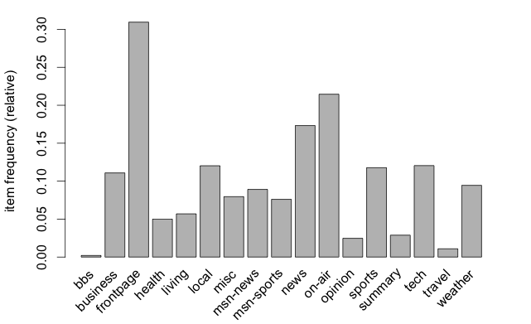
Item Frequency

Slide 3
Itemset Size Distribution

Slide 4
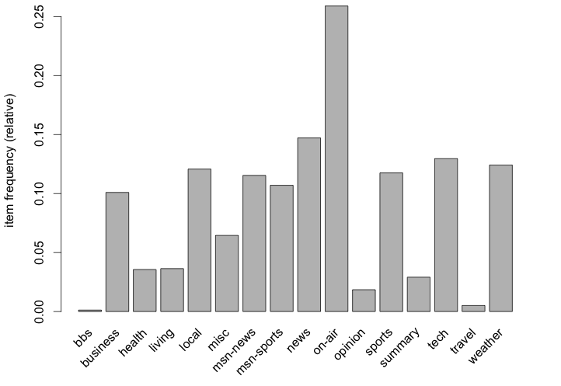
Item Frequency

Slide 5
Itemset Size Distribution without “frontpage”

Slide 6
Rules Visualization with arulesViz
17 rules : min support = 1%, min confidence = 50%
Visualization types:
Scatter plot
Grouped
Graph
Parallel coordinate

Slide 7
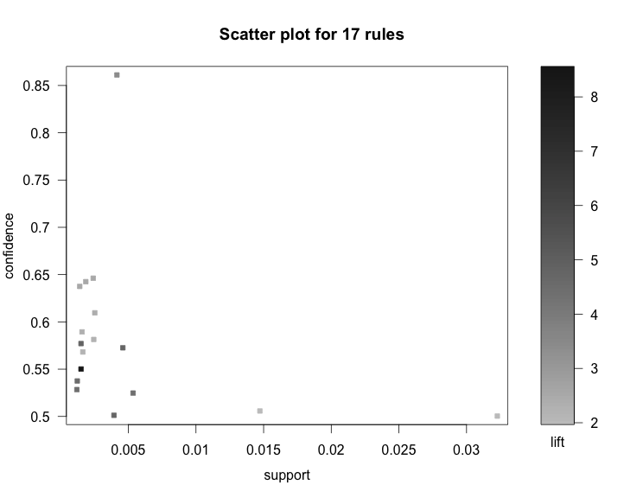

Slide 8
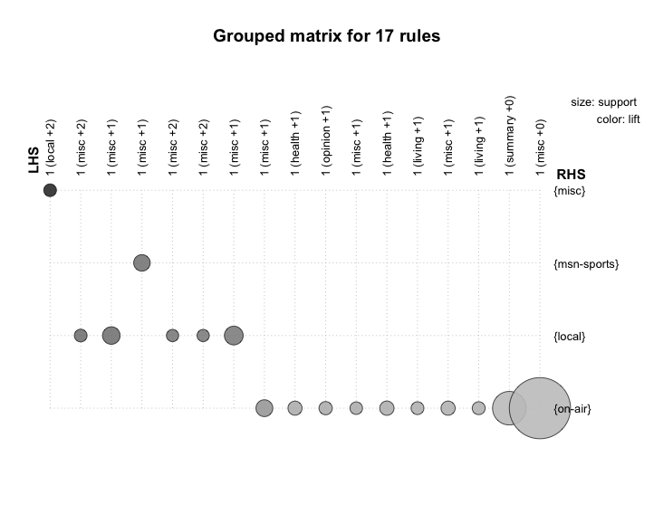

Slide 9
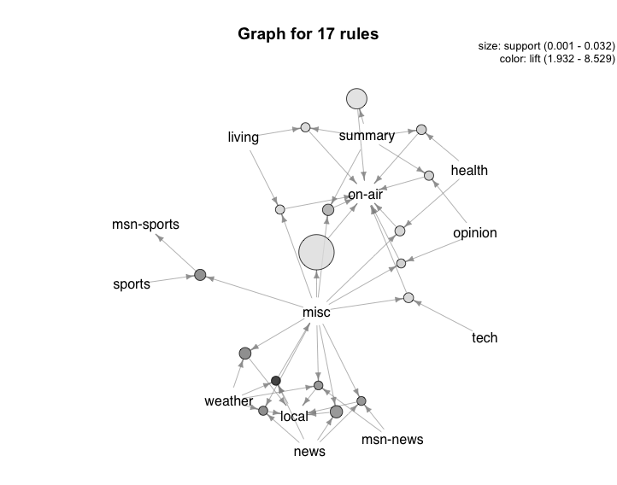

Slide 10
